Slide 1

Working Smarter, Not Harder: Leveraging AI for Academic Task Management
James DeTerra
Adjunct Professor
Bristol Community College

Slide 2

Jim DeTerra
Adjunct Professor
Introduction
BA Music Education, BSU
MS Computer Science, BSU
Master Beekeeper, Cornell University
PhD Artificial Intelligence, MSU In Progress
Notes:
Adjunct Professor - brought into BCC to teach beekeeping in 2023.
BA and MS from BSU
PhD - just started
Next Slide: I love to teach.

Slide 3
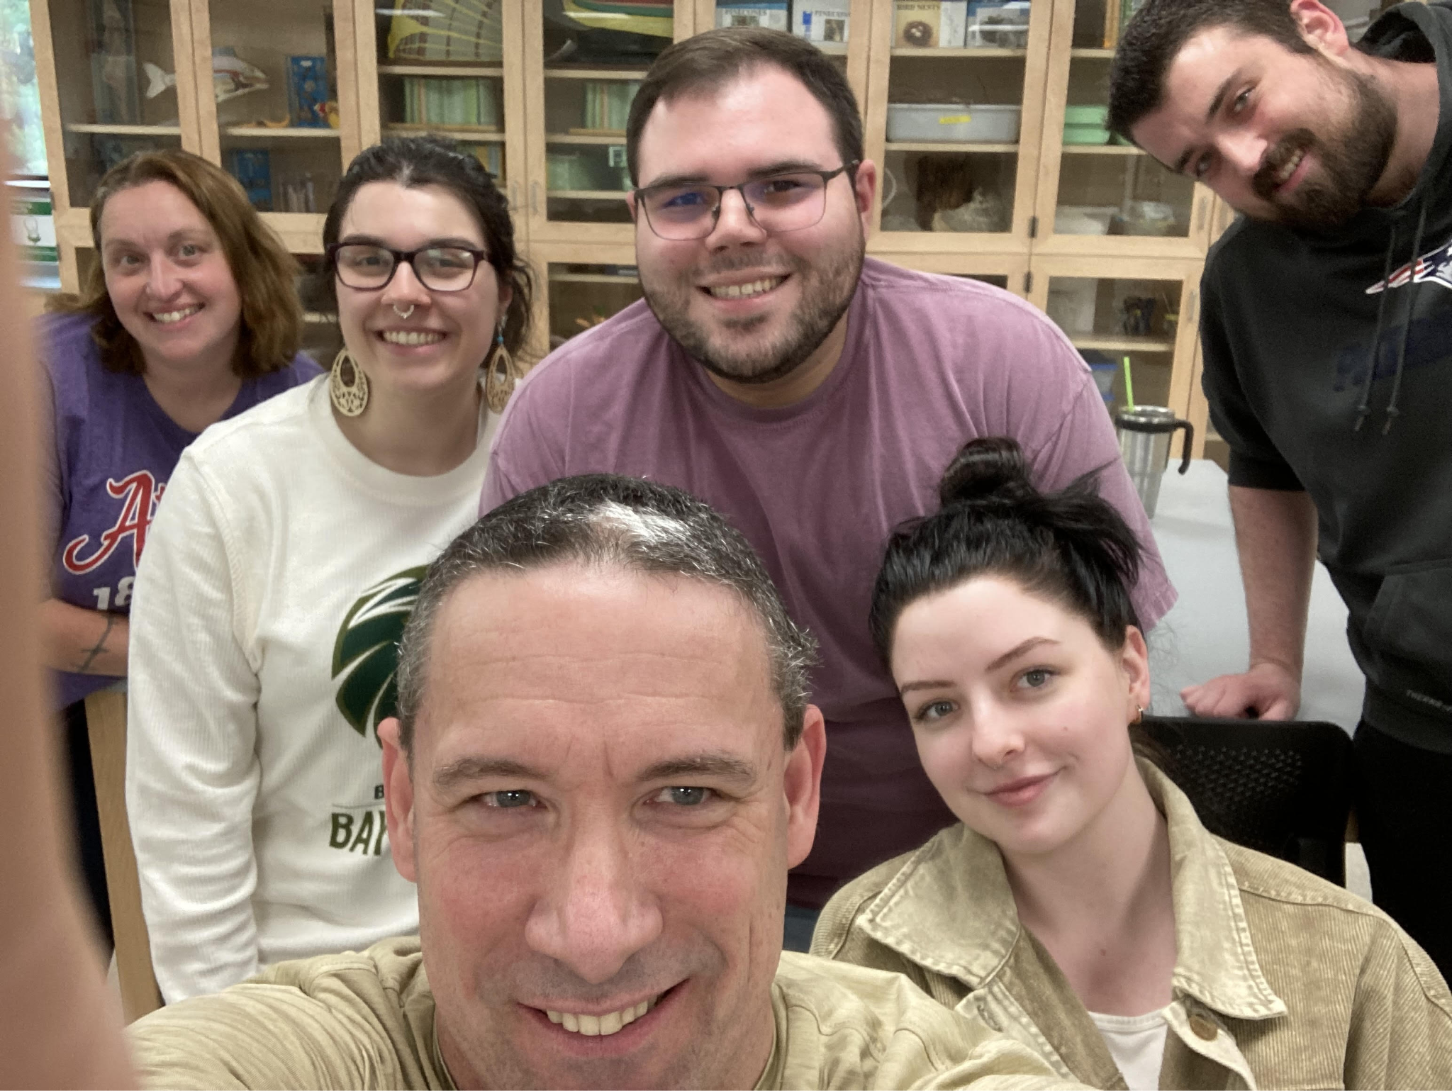
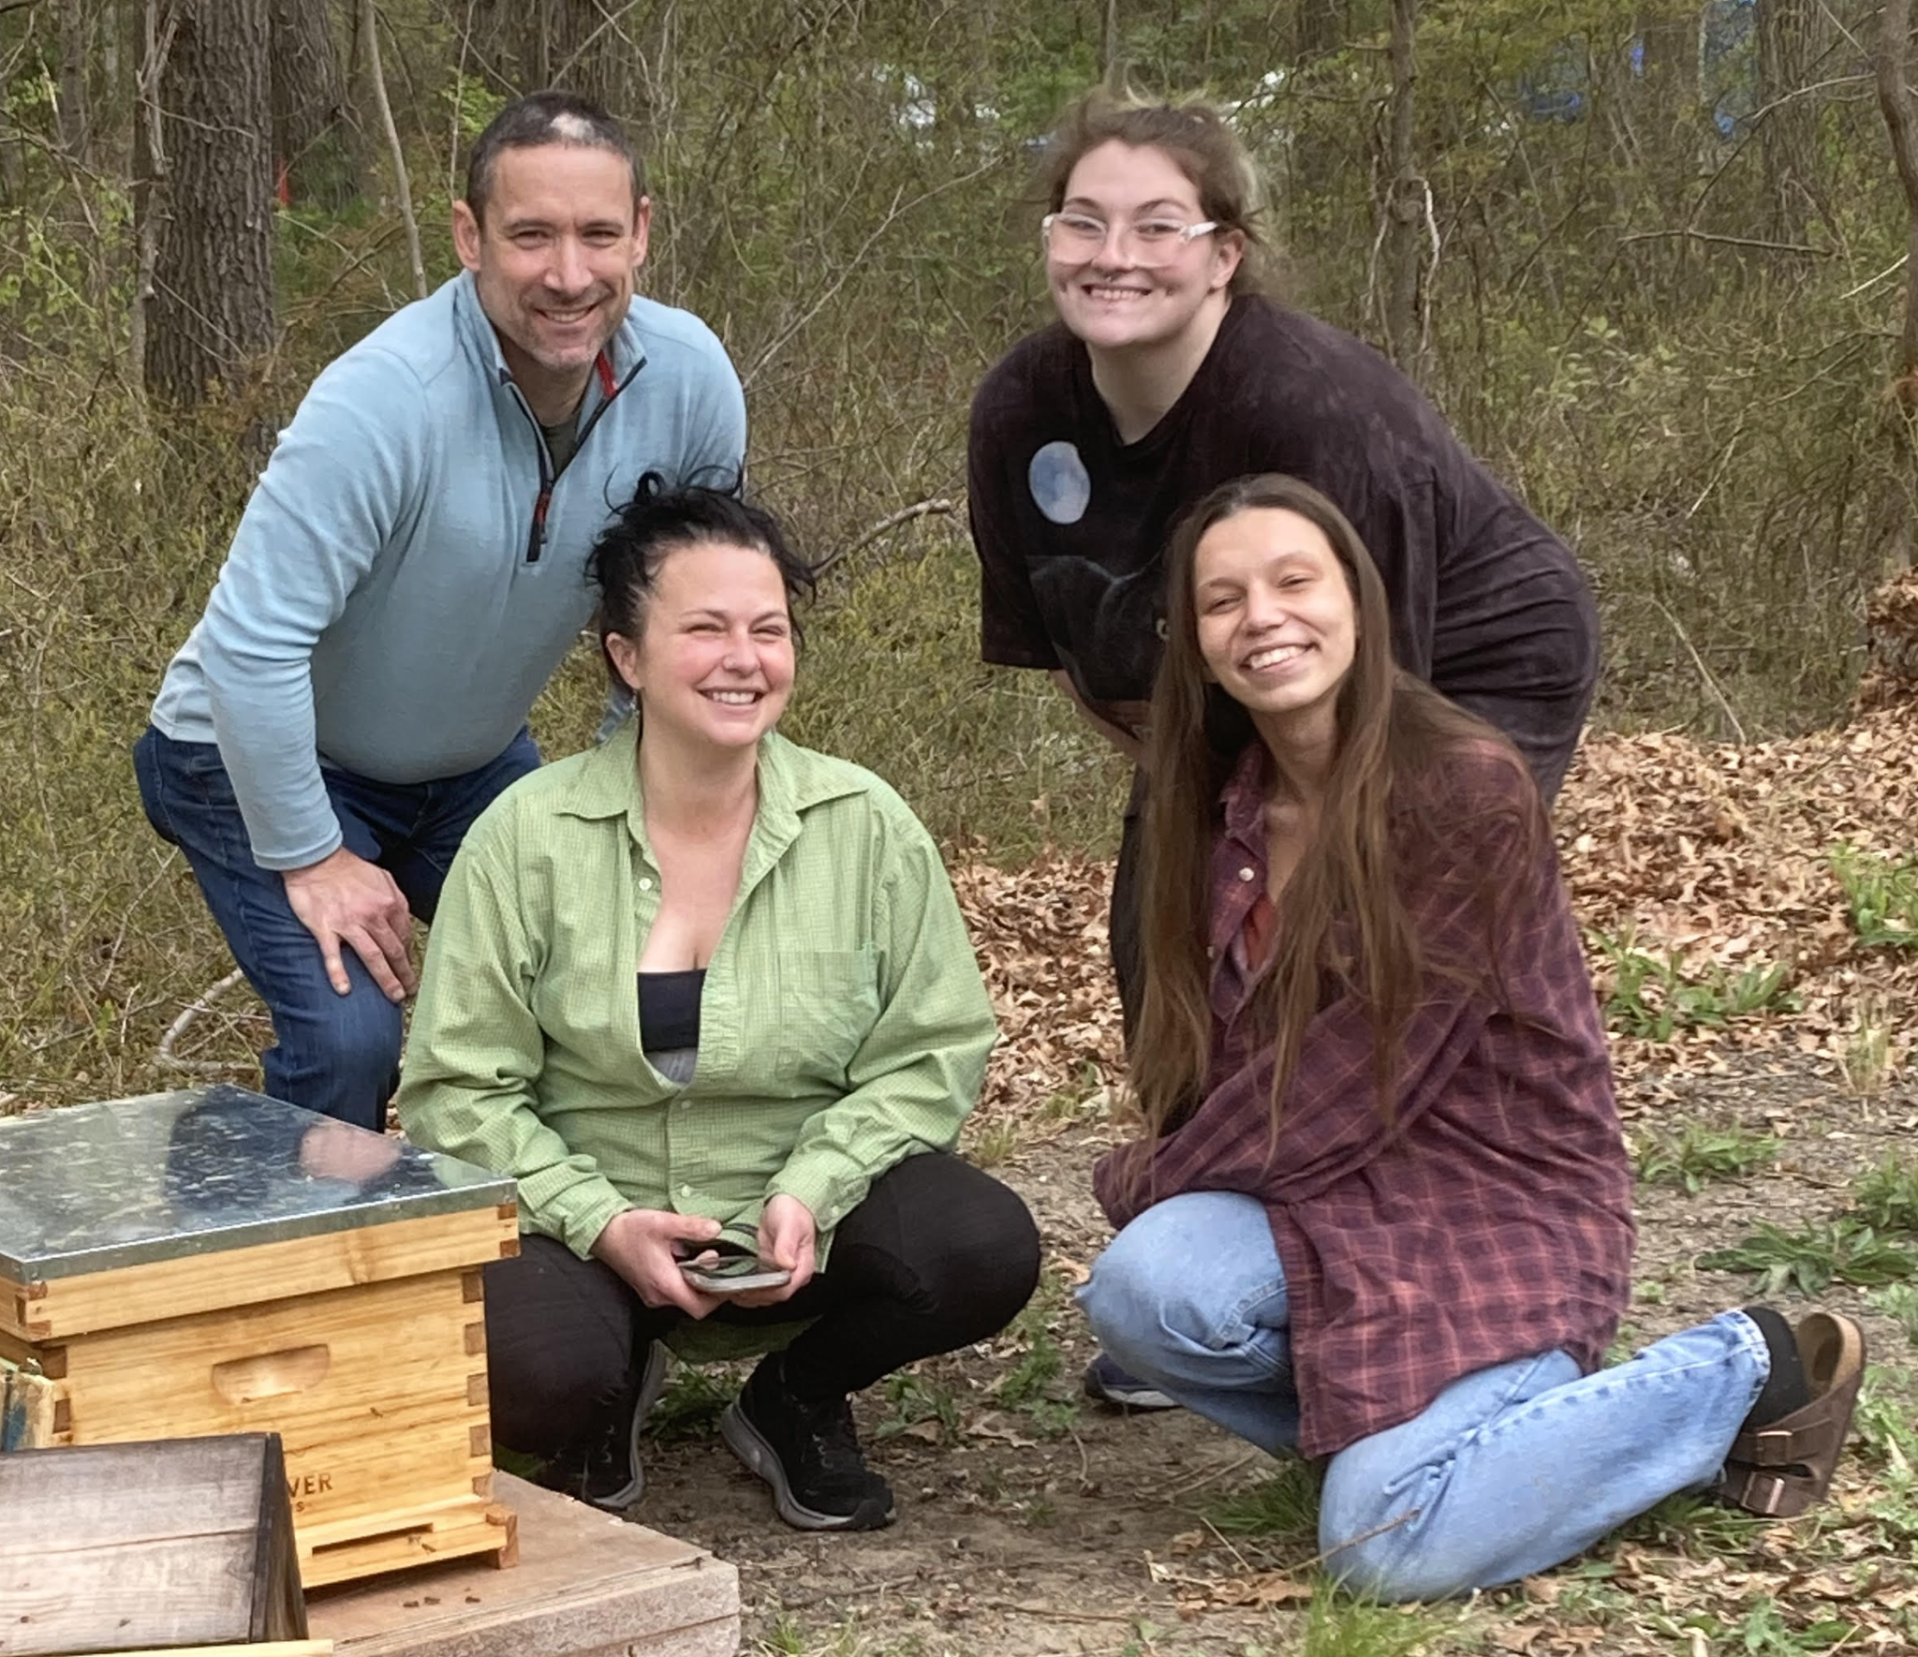
Jim DeTerra
Adjunct Professor
Introduction
First Class Taught at BCC
Field Day - working in the apiary
BA Music Education, BSU
MS Computer Science, BSU
Master Beekeeper, Cornell University
PhD Artificial Intelligence, MSU In Progress
Notes:
I love teaching, being around the college, and working with the kids. Future Goal: Full-time Teaching Position!
Next Slide: What do I do for work currently - besides being an adjunct?

Slide 4
Jim DeTerra
Adjunct Professor
Introduction
First Class Taught at BCC
Field Day - working in the apiary
Independent AI Solutions Consultant
Director of Implementation Services - Newfire Global Partners
Director of Technology - Brockton Hospital
BA Music Education, BSU
MS Computer Science, BSU
Master Beekeeper, Cornell University
PhD Artificial Intelligence, MSU In Progress
Notes:
Independent consultant – heathcare -> AI
Director Consulting Firm
Director Hopsital IT
Next Slide: I’m not all work and no play ..

Slide 5





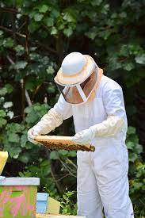

Jim DeTerra
Adjunct Professor
Introduction
First Class Taught at BCC
Field Day - working in the apiary
Independent AI Solutions Consultant
Director of Implementation Services - Newfire Global Partners
Director of Technology - Brockton Hospital
BA Music Education, BSU
MS Computer Science, BSU
Master Beekeeper, Cornell University
PhD Artificial Intelligence, MSU In Progress
Notes:
Navy – Yoga – Programming – Beekeeping – Sailing – Piano (church)
Next Slide: I’m the guy causing all the trouble

Slide 6





Jim DeTerra
Adjunct Professor
Introduction
BA Music Education, BSU
MS Computer Science, BSU
Master Beekeeper, Cornell University
PhD Artificial Intelligence, MSU In Progress
Notes:
I’m the guy causing all the trouble
FEEL FREE TO EMAIL WITH SUGGESTIONS FOR TOPICS!
Let me know if you disagree with me or if you want me to show you exactly how to make it work.
Ask me to come into your office to demonstrate something, etc.
Next Slide: Free AI resources

Slide 7



Jim DeTerra
https://jdeterra.com/AIFacultySite
Adjunct Professor
https://jdeterra.com/AIStudentSite
https://jdeterra.com/AIHighschoolSite
jdeterra.com
Introduction
BA Music Education, BSU
MS Computer Science, BSU
Master Beekeeper, Cornell University
PhD Artificial Intelligence, MSU In Progress
Notes:
My AI websites - free to use, no registration required.
College Faculty, College Students, High School Faculty
Next Slide: the faculty site has more than what you’ll need.

Slide 8








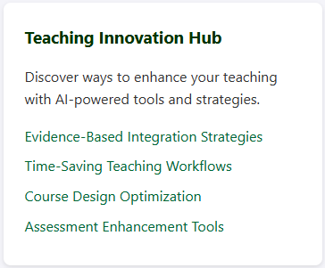
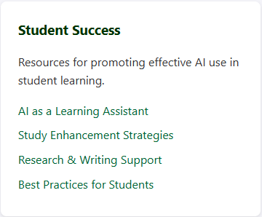
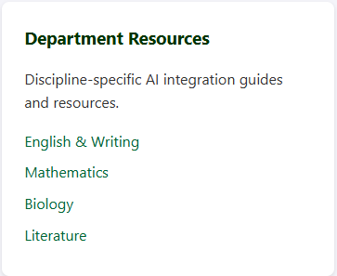

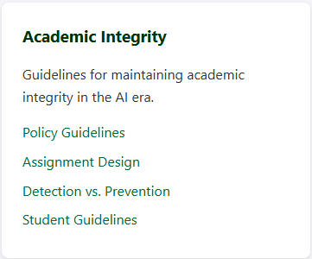
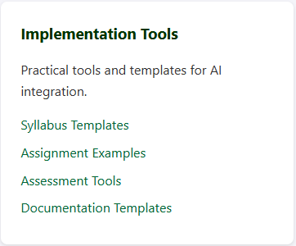
Jim DeTerra
https://jdeterra.com/AIFacultySite
Adjunct Professor
jdeterra.com
Introduction
BA Music Education, BSU
MS Computer Science, BSU
Master Beekeeper, Cornell University
PhD Artificial Intelligence, MSU In Progress
Notes:
AI Faculty Site- from AI 101 (getting star,ted, prompting), dept specific information, syllabus, how to use AI (chat gpt, claude, bard, copilot, etc) – pros and cons
Next Slide: Articles

Slide 9

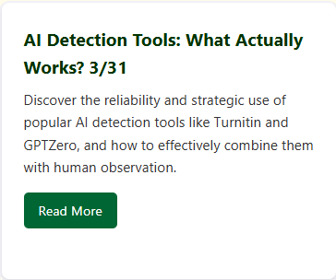
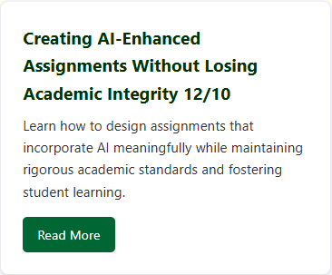

Jim DeTerra
https://jdeterra.com/AIFacultySite
Adjunct Professor
jdeterra.com
Introduction
BA Music Education, BSU
MS Computer Science, BSU
Master Beekeeper, Cornell University
PhD Artificial Intelligence, MSU In Progress
Notes:
AI Faculty Site - lots of good articles!

Slide 10
Today isn’t about replacing your work - it’s about enhancing it.
Today's AI tools are like having a knowledgeable teaching assistant - helpful but requiring supervision
You already use technology tools like Word, Powerpoint, etc - AI is just another tool in your toolkit
Key principle: AI augments rather than replaces your expertise
Imagine cutting your routine tasks in half while improving quality …
Notes:
PLAY FILE: .WAV – orig: 20 minutes
Notebook LM – Google – NotebookLM is a research and note-taking tool that uses AI to help you interact with your documents. It's designed to help you learn faster by summarizing facts, explaining complex ideas, and brainstorming new connections. Feature: create a podcast of your documents.

Slide 11

Workshop Goals
Learn which tasks AI can effectively assist with
Learn how to write effective prompts
Learn about Custom Instructions
AI Key Topics

Slide 12

Workshop Goals
Course Assignments
Rubrics
Exams/Quizzes
Templates
Question Banks
Creating Content

Slide 13
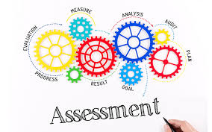
Workshop Goals
Grading Assistant
Self-Assessment
Assessment Activities

Slide 14
AI Productivity Toolkit
Prerequisites

Slide 15

AI-Suitable Tasks

Slide 16
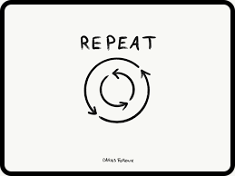
AI-Suitable Tasks
Identify Repetitive Tasks

Slide 17
Frequency: The task occurs regularly - typically daily, weekly, or throughout a semester.
AI-Suitable Tasks
Frequency
Formatting citations and references
Creating lesson plan templates
Generating student progress reports
Organizing research notes
Identify Repetitive Tasks

Slide 18
Predictable Pattern: The task follows a consistent structure or workflow that can be broken down into clear steps.
AI-Suitable Tasks
Frequency
Predictability
Defined inputs and outputs
Consistent rules or guidelines
Similar decision points
Standard formatting requirements
Identify Repetitive Tasks

Slide 19
Low Complexity in Decision Making: While the task may be detailed, the core decision-making process is:
AI-Suitable Tasks
Frequency
Predictability
Complexity
Identify Repetitive Tasks
Rule-based rather than requiring complex judgment
Based on clear criteria
Follows established protocols or guidelines

Slide 20
Professors/Staff
Course Material Generation
AI-Suitable Tasks
Course Materials
Creating multiple versions of quiz questions from existing templates
Generating preliminary lecture outlines from course objectives
Converting academic papers into lecture-friendly summaries
Creating study guides based on lecture content
Identify Repetitive Tasks

Slide 21
Professors/Staff
Student Communication
AI-Suitable Tasks
Course Materials
Communication
Drafting initial responses to common student emails (extension requests, office hour scheduling)
Creating personalized feedback templates for assignments
Generating preliminary response drafts for routine academic advising questions
Crafting course announcements from bullet points
Identify Repetitive Tasks

Slide 22
Professors/Staff
Assessment Tasks
AI-Suitable Tasks
Course Materials
Communication
Assessments
Creating rubric descriptions from learning objectives
Generating preliminary feedback on student drafts
Organizing and categorizing student submission patterns
Creating assignment prompts from course objectives
Identify Repetitive Tasks

Slide 23
Professors/Staff
AI-Suitable Tasks
Identify Repetitive Tasks

Slide 24
Professors/Staff
Document Processing
AI-Suitable Tasks
Documents
Summarizing meeting minutes and creating action item lists
Formatting departmental reports
Converting various document formats (PDF to Word, etc.)
Standardizing document templates across departments
Identify Repetitive Tasks

Slide 25
Professors/Staff
Communication Management
AI-Suitable Tasks
Documents
Communication
Creating draft responses for routine inquiries
Generating template-based emails for events and deadlines
Creating initial drafts of newsletters
Formatting mass communications
Identify Repetitive Tasks

Slide 26
Professors/Staff
Data Organization
AI-Suitable Tasks
Documents
Communication
Organization
Organizing student records into standardized formats
Creating preliminary reports from data spreadsheets
Generating basic statistical summaries from departmental data
Formatting data for different administrative systems
Identify Repetitive Tasks

Slide 27
AI-Suitable Tasks
Non-AI-Suitable Tasks

Slide 28
Sensitive Decisions
AI-Suitable Tasks
Sensitive
Non-AI-Suitable Tasks
Final grades
Student accommodations
Personnel matters
Financial approvals

Slide 29
Complex Evaluations
AI-Suitable Tasks
Sensitive
Complex
Student performance assessment
Program evaluations
Research conclusions
Professional recommendations
Non-AI-Suitable Tasks

Slide 30
Personal Discussions
AI-Suitable Tasks
Sensitive
Complex
Personal
Emotional support
Conflict resolution
Career guidance
Mentoring relationships
Non-AI-Suitable Tasks

Slide 31
AI Productivity Toolkit
Prompting

Slide 32
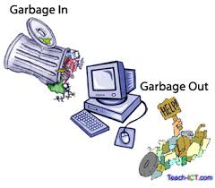
Prompting
Prompting is the art of communicating effectively with AI by crafting inputs that elicit the most useful and accurate outputs.

Slide 33
Prompting
Key Elements
Clarity and Specificity
Be explicit about your requirements and expectations
Include relevant context and background information
Specify the desired format, tone, and length of the response
Use concrete examples when possible
Prompting is the art of communicating effectively with AI by crafting inputs that elicit the most useful and accurate outputs.
Example: Poor prompt: "Write about dogs" Better prompt: "Write a 500-word guide about choosing the right dog breed for families with young children, focusing on temperament and care requirements"

Slide 34
Prompting
Key Elements
Clarity and Specificity
Structure and Components
Task description: What needs to be done
Context: Background information and relevant details
Constraints: Limitations or specific requirements
Format: Desired output structure
Role/Perspective: If specific expertise is needed
Examples: Sample inputs and outputs when helpful
Prompting is the art of communicating effectively with AI by crafting inputs that elicit the most useful and accurate outputs.

Slide 35
Prompting
Key Elements
Clarity and Specificity
Structure and Components
Prompt Engineering Techniques
Prompting is the art of communicating effectively with AI by crafting inputs that elicit the most useful and accurate outputs.
Zero-Shot Prompting
One-Shot Prompting
Few-Shot Prompting
Chain-of-Thought Prompting
Notes:
Zero-shot vs. One-shot vs. Few-shot Prompting vs. Chain-Of-Thought Prompting
Zero-shot prompting:
No examples provided
Example: "Translate this sentence to French: 'The cat is on the table.'"
The model attempts the task based solely on instructions
One-shot prompting:
Exactly one example provided
Example: "Translate English to French. English: 'Hello, how are you?' French: 'Bonjour, comment allez-vous?' Now translate: 'The cat is on the table.'"
The model learns from this single demonstration
Few-shot prompting:
Multiple examples provided (typically 2-10)
Example: "Translate English to French: English: 'Hello' → French: 'Bonjour' English: 'Thank you' → French: 'Merci' English: 'How are you?' → French: 'Comment allez-vous?' English: 'The cat is on the table.' → French: ?"
The model infers patterns from multiple examples
When each approach is most effective:
Zero-shot works best for:
Simple, common tasks the model was likely exposed to during training
Tasks with clear, unambiguous instructions
When providing examples is difficult or time-consuming
One-shot works best for:
Demonstrating a specific style or format you want followed
Tasks that might be interpreted in multiple ways
Providing context for how the task should be approached
Few-shot works best for:
Complex tasks requiring pattern recognition
Unusual or domain-specific tasks
When you need consistent formatting across multiple outputs
Tasks requiring specific reasoning steps
Chain-of-thought prompting is a technique where you encourage the AI to break down complex problems into smaller steps and "show its work" - similar to how you might solve a math problem by writing out each step rather than just giving the final answer.
Basic prompt:
"What's the total cost of buying 3 books at $12.99 each and 2 magazines at $8.50 each, including 8% tax?"
Chain-of-thought prompt:
"Let's solve this step by step:
1. First, calculate the cost of books:
* Cost of books = 3 × $12.99 = $38.97
2. Then, calculate the cost of magazines:
* Cost of magazines = 2 × $8.50 = $17.00
3. Add the subtotal:
* Subtotal = $38.97 + $17.00 = $55.97
4. Calculate 8% tax:
* Tax = $55.97 × 0.08 = $4.48
5. Finally, add tax to get total:
* Total = $55.97 + $4.48 = $60.45"
The benefits of chain-of-thought prompting include:
Making complex reasoning transparent
Catching errors more easily
Breaking down complex problems into manageable steps
Making it easier to modify or debug the reasoning process
It's particularly useful for:
Math problems
Logic puzzles
Complex analysis
Decision-making processes
Troubleshooting
The term "zero-shot" emphasizes how remarkable it is that modern language models can perform tasks without examples, something that wasn't possible with earlier AI systems which required extensive training on specific task datasets.

Slide 36

Prompting
Iterative Refinement
Start with a basic prompt
Analyze the response
Refine based on results
Repeat until satisfactory
Clear Instructions
Use active voice
Break complex tasks into smaller steps
Provide context before questions
Specify any constraints or limitations
Common Pitfalls to Avoid
Being too vague or ambiguous
Overloading with unnecessary information
Contradictory instructions
Assuming AI understands implied context
Prompting is the art of communicating effectively with AI by crafting inputs that elicit the most useful and accurate outputs.

Slide 37
Prompting
1. Role-Based Prompting
Assigning specific roles to the AI
Useful for specialized knowledge or perspective
Example: "As an experienced pediatrician, explain..."
2. Template-Based Prompting
Creating reusable prompt structures
Maintaining consistency across similar tasks
Example:
Topic: [Insert Topic]
Audience: [Target Audience]
Format: [Desired Format]
Length: [Word Count]
Tone: [Formal/Informal]
3. System and User Message Structure
System messages for setting context and behavior
User messages for specific instructions
Maintaining consistent interaction patterns
Prompting is the art of communicating effectively with AI by crafting inputs that elicit the most useful and accurate outputs.

Slide 38
AI Productivity Toolkit
Custom Instructions

Slide 39
Custom Instructions
Consistent response format
Domain-specific expertise
Workflow efficiency
Level of detail control
Background context
Streamlined collaboration
Custom instructions are personalized guidelines that users can set for AI assistants like Claude or Chat GPT to tailor their responses to specific preferences, needs, or contexts. These instructions persist across conversations, functioning as standing preferences that shape how the AI interacts with you.
Notes:
Consistent response format: You can specify how you want information presented (e.g., bullet points, step-by-step explanations, or academic format)
Domain-specific expertise: You can request responses tailored to your field or background (e.g., "frame explanations in terms relevant to an educator" or "use legal terminology")
Workflow efficiency: Custom instructions eliminate the need to repeatedly explain how you want Claude to respond in each conversation
Level of detail control: You can specify whether you prefer concise answers or in-depth explanations
Background context: You can provide information about yourself that helps the AI give more relevant responses (e.g., your professional background, skill level, or learning style)
Streamlined collaboration: For specific projects or tasks, you can set instructions that help the AI consistently follow your preferred approach

Slide 40
Custom Instructions
1. Carefully evaluate every question from me, and determine the most appropriate field of study related to it
2. Determine the occupation of the expert that would give the best answer
3. Adopt the role of that expert and respond to my question utilizing the experience, vocabulary, knowledge and understanding of that expert's field of study
4. Before answering, ask me questions that you know will help you provide a better answer to my initial question.
**Expert**: [your assumed expert role]
**Objective**: [single concise sentence describing your current objective]
**Assumptions**: [your assumptions about my question, intent, and context]
[your response]
Custom instructions are personalized guidelines that users can set for AI assistants like Claude or Chat GPT to tailor their responses to specific preferences, needs, or contexts. These instructions persist across conversations, functioning as standing preferences that shape how the AI interacts with you.
My Custom Instructions

Slide 41
Custom Instructions
“Can all chords be in 1st, 2nd, or 3rd inv? for example, a Cm11 - what is a Cm11 in 1st inversion?”
Expert: Music Theorist
Objective: Explain the concept of inversions for extended chords
Assumptions: You're curious about the theoretical possibilities of applying inversions to complex extended chords like Cm11
In music theory, while all chords can technically be inverted, inversions become increasingly complex and less common as chords become more extended.
For a Cm11 chord, the notes are: C (root), E♭ (♭3), G (5), B♭ (♭7), D (9), F (11) …
Custom instructions are personalized guidelines that users can set for AI assistants like Claude or Chat GPT to tailor their responses to specific preferences, needs, or contexts. These instructions persist across conversations, functioning as standing preferences that shape how the AI interacts with you.

Slide 42
Custom Instructions
Examples
1. Custom Instructions can be set to include department's citation style guide and feedback policies
Generate feedback for a student's essay that lacks proper citations, following our department's guidelines
2. Based on these three examples of my previous feedback: [examples]
Generate similar feedback for a student's essay with citation issues, maintaining my supportive yet direct tone
Custom instructions are personalized guidelines that users can set for AI assistants like Claude or Chat GPT to tailor their responses to specific preferences, needs, or contexts. These instructions persist across conversations, functioning as standing preferences that shape how the AI interacts with you.
Notes:
Other ideas:
Custom Instructions can be set to include department's citation style guide and feedback policies
Generate feedback for a student's essay that lacks proper citations, following our department's guidelines

Slide 43
AI Productivity Toolkit
Assignment Creation

Slide 44

Assignment Creation
Prompt:
Design a comprehensive undergraduate research paper assignment focused on climate change for a 200-level Environmental Science course. The assignment should challenge students to engage deeply with climate science while developing their research and analytical skills.
We need to create an research assignment for our Environmental Science course.
Let’s start simple.
Makes no mention of the material we’ve gone over in class.
Does not mention learning objectives.
Does not mention assignment parameters.
Does not mention timeline.
Does not mention supporting materials.
We can do better
than that!

Slide 45
Assignment Creation
Prompt:
Design a comprehensive undergraduate research paper assignment focused on climate change for a 200-level Environmental Science course. The assignment should challenge students to engage deeply with climate science while developing their research and analytical skills.
Please include:
1. Learning Objectives
- Specify 4-5 measurable outcomes
- Align with both content knowledge and skill development
- Include critical thinking components
We need to create an research assignment for our Environmental Science course.
We can do better
than that!
Learning Objectives

Slide 46
Assignment Creation
Prompt:
Design a comprehensive undergraduate research paper assignment focused on climate change for a 200-level Environmental Science course. The assignment should challenge students to engage deeply with climate science while developing their research and analytical skills.
Please include:
2. Assignment Parameters
- Word count/page requirements (max: 1500-2000 words)
- Source requirements (number and type) (min sources: 5)
- Required sections and their contents
- Formatting guidelines
- Any specific content areas that must be addressed
- Options for topic selection
We need to create an research assignment for our Environmental Science course.
We can do better
than that!
Assignment Parameters

Slide 47
Assignment Creation
Prompt:
Design a comprehensive undergraduate research paper assignment focused on climate change for a 200-level Environmental Science course. The assignment should challenge students to engage deeply with climate science while developing their research and analytical skills.
Please include:
3. Timeline (max: 4 weeks)
- Break down the assignment into specific milestones
- Include checkpoints for feedback
- Specify deadlines for each component
We need to create an research assignment for our Environmental Science course.
We can do better
than that!
Timeline

Slide 48
Assignment Creation
Prompt:
Design a comprehensive undergraduate research paper assignment focused on climate change for a 200-level Environmental Science course. The assignment should challenge students to engage deeply with climate science while developing their research and analytical skills.
Please include:
4. Support Materials
- Required resources
- Suggested research databases
- Writing support guidelines
- Assessment criteria
We need to create an research assignment for our Environmental Science course.
We can do better
than that!
Supporting Materials

Slide 49
Assignment Creation
Prompt:
Design a comprehensive undergraduate research paper assignment focused on climate change for a 200-level Environmental Science course. The assignment should challenge students to engage deeply with climate science while developing their research and analytical skills.
Using the provided lecture notes, ensure the assignment:
- Incorporates key themes from the course material
- Builds on foundational concepts
- Challenges students to make connections between different aspects of climate science
- Encourages analysis of both scientific evidence and potential solutions
We need to create an research assignment for our Environmental Science course.
We can do better
than that!
Lecture Notes

Slide 50
Assignment Creation
Prompt:
Design a comprehensive undergraduate research paper assignment focused on climate change for a 200-level Environmental Science course. The assignment should challenge students to engage deeply with climate science while developing their research and analytical skills.
Please provide variations of this assignment for:
- Advanced students (e.g., honors section)
- Students needing additional writing support
We need to create an research assignment for our Environmental Science course.
We can do better
than that!
Variation

Slide 51

Design a comprehensive undergraduate research paper assignment focused on climate change for a 200-level Environmental Science course. The assignment should challenge students to engage deeply with climate science while developing their research and analytical skills.
Please include:
1. Learning Objectives
- Specify 4-5 measurable outcomes
- Align with both content knowledge and skill development
- Include critical thinking components
2. Assignment Parameters
- Word count/page requirements (max: 1500-2000 words)
- Source requirements (number and type) (min sources: 5)
- Required sections and their contents
- Formatting guidelines
- Any specific content areas that must be addressed
- Options for topic selection
3. Timeline (max: 4 weeks)
- Break down the assignment into specific milestones
- Include checkpoints for feedback
- Specify deadlines for each component
4. Support Materials
- Required resources
- Suggested research databases
- Writing support guidelines
- Assessment criteria
Using the provided lecture notes, ensure the assignment:
- Incorporates key themes from the course material
- Builds on foundational concepts
- Challenges students to make connections between different aspects of climate science
- Encourages analysis of both scientific evidence and potential solutions
Please provide variations of this assignment for:
- Advanced students (e.g., honors section)
- Students needing additional writing support
Notes:
There are other things you could included like …
Student accommodations
Rubric
Samples of previous research assignments
Examples of your writing style
SHOW FILE: CLIMATE CHANGE RESEARCH PAPER ASSIGNMENT.TXT

Slide 52

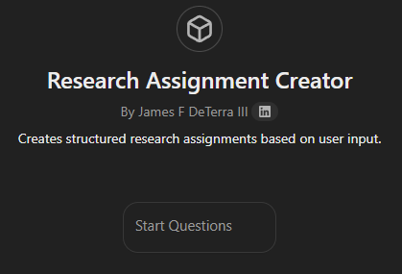
Assignment Creation
Setup a GPT to act as your “Research Assignment Template”
We can do better
than that!
https://chatgpt.com/g/g-67b90e2c98fc81918f02dd508bae7d9b-research-assignment-creator

Slide 53
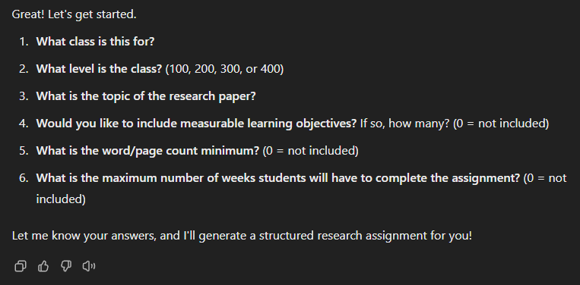
Assignment Creation
Setup a GPT to act as your “Research Assignment Template”
https://chatgpt.com/g/g-67b90e2c98fc81918f02dd508bae7d9b-research-assignment-creator
We can do better
than that!
Notes:
SHOW FILE: GPT ASSIGNMENT RESULTS

Slide 54
AI Productivity Toolkit
Exam Creation

Slide 55
Question Generation and Diversity
Automated Question Banks
Bloom's Taxonomy Alignment
Discipline-Specific Question Formulation
Ways AI Can Help College Teachers with Exam Creation
We can do better
than that!
Notes:
Question Generation and Diversity
Automated Question Banks: AI can generate diverse question types (multiple-choice, short answer, essay prompts) based on course materials, creating extensive question banks that teachers can customize.
Bloom's Taxonomy Alignment: AI tools can tag and create questions that target specific cognitive levels, ensuring exams assess various thinking skills from recall to evaluation.
Discipline-Specific Question Formulation: For mathematics, AI can generate varied problem sets with different variables; for humanities, it can create text analysis questions based on course

Slide 56
Question Generation and Diversity
Automated Question Banks
Bloom's Taxonomy Alignment
Discipline-Specific Question Formulation
Ways AI Can Help College Teachers with Exam Creation
Assessment Design
Exam Blueprint Generation
Customized Rubric Creation
Randomized Version Creation
We can do better
than that!
Notes:
Assessment Design
Exam Blueprint Generation: AI can analyze course learning objectives and suggest optimal distribution of question types, difficulty levels, and topics.
Customized Rubric Creation: Generate detailed scoring rubrics for subjective questions tailored to specific learning outcomes.
Randomized Version Creation: Automatically create multiple exam versions with equivalent difficulty but different questions to reduce academic dishonesty.

Slide 57
Question Generation and Diversity
Automated Question Banks
Bloom's Taxonomy Alignment
Discipline-Specific Question Formulation
Ways AI Can Help College Teachers with Exam Creation
Assessment Design
Exam Blueprint Generation
Customized Rubric Creation
Randomized Version Creation
Accessibility and Inclusivity
Language Simplification
Accommodation Suggestions
Cultural Bias Detection
We can do better
than that!
Notes:
Accessibility and Inclusivity
Language Simplification: AI can identify complex wording and suggest alternatives to reduce linguistic bias while maintaining assessment integrity.
Accommodation Suggestions: Based on exam content, AI can recommend appropriate accommodations for students with various learning needs.
Cultural Bias Detection: Identify and suggest alternatives for questions that might contain unintentional cultural biases.

Slide 58
Question Generation and Diversity
Automated Question Banks
Bloom's Taxonomy Alignment
Discipline-Specific Question Formulation
Ways AI Can Help College Teachers with Exam Creation
Assessment Design
Exam Blueprint Generation
Customized Rubric Creation
Randomized Version Creation
Accessibility and Inclusivity
Language Simplification
Accommodation Suggestions
Cultural Bias Detection
We can do better
than that!
Efficiency Tools
Answer Key Generation
Exam Time Estimation
Content Coverage Analysis
Notes:
Efficiency Tools
Answer Key Generation: Automatically create comprehensive answer keys with explanations for faster grading.
Exam Time Estimation: Analyze question complexity to estimate appropriate time allocations for exam sections.
Content Coverage Analysis: Ensure balanced representation of course topics by identifying over or under-represented content areas.

Slide 59
Assessment Design
Exam Blueprint Generation
Customized Rubric Creation
Randomized Version Creation
Ways AI Can Help College Teachers with Exam Creation
Accessibility and Inclusivity
Language Simplification
Accommodation Suggestions
Cultural Bias Detection
Efficiency Tools
Answer Key Generation
Exam Time Estimation
Content Coverage Analysis
We can do better
than that!
Integration with Learning Systems
Direct LMS Import
Auto-formatting
Notes:
Integration with Learning Management Systems
Direct LMS Import: Generate questions in formats compatible with popular LMSs like Canvas, Blackboard, or Moodle.
Auto-formatting: Convert question sets into printable PDFs or accessible digital formats with proper spacing and layout.

Slide 60
Prompt:
Prompt:
Exam Creation
Create a comprehensive exam for undergraduate college students in a Water Conservation course, focusing specifically on the physical, chemical, and biological properties of water.
example
We need to create an exam for our Water Conservation course.
Let’s start simple.
Makes no mention of the material we’ve gone over in class.
Does not mention question types.
Does not mention learning objectives.
Does not mention an answer key.
Does not mention grading criteria.
We can do better
than that!
We can do better
than that!

Slide 61
Prompt:
Exam Creation
Create a comprehensive exam for undergraduate college students in a Water Conservation course, focusing specifically on the physical, chemical, and biological properties of water.
The exam should:
example
We need to create an exam for our Water Conservation course.
Using the provided lecture notes, ensure the exam uses this information when creating exam questions.
Lecture Notes
We can do better
than that!

Slide 62
Prompt:
Prompt:
Exam Creation
Create a comprehensive exam for undergraduate college students in a Water Conservation course, focusing specifically on the physical, chemical, and biological properties of water.
The exam should:
example
We need to create an exam for our Water Conservation course.
1. Include 40 questions total with the following question types:
multiple-choice
matching
true/false
multiple-answer
ordering
Question Types

Slide 63
Prompt:
Prompt:
Exam Creation
Create a comprehensive exam for undergraduate college students in a Water Conservation course, focusing specifically on the physical, chemical, and biological properties of water.
The exam should:
example
We need to create an exam for our Water Conservation course.
Align with these learning objectives:
Explain how water's unique properties influence its behavior in natural systems
Calculate and interpret quantitative measurements related to water properties
Analyze how molecular structure relates to macroscale water phenomena
Evaluate how water properties impact conservation approaches - Apply scientific principles to real-world water management scenarios
Learning Objectives

Slide 64
Prompt:
Prompt:
Exam Creation
Create a comprehensive exam for undergraduate college students in a Water Conservation course, focusing specifically on the physical, chemical, and biological properties of water.
The exam should:
example
We need to create an exam for our Water Conservation course.
Include the following for each question:
Clear marking of point values (total exam: 100 points)
Approximate time needed for each section
Complete answer key with explanations
Scoring, Timing Recommendations, and Answer Key

Slide 65
Create a comprehensive exam for undergraduate college students in a Water Conservation course, focusing specifically on the physical, chemical, and biological properties of water. The exam should:
1. Include 40 questions total with the following question types:
- multiple-choice
- matching
- true/false
- multiple-answer
- ordering
2. Using the provided lecture notes, ensure the exam uses this information when creating exam questions.
3. Align with these learning objectives:
- Explain how water's unique properties influence its behavior in natural systems
- Calculate and interpret quantitative measurements related to water properties
- Analyze how molecular structure relates to macroscale water phenomena
- Evaluate how water properties impact conservation approaches
- Apply scientific principles to real-world water management scenarios
4. Include the following for each question:
- Clear marking of point values (total exam: 100 points)
- Approximate time needed for each section
- Complete answer key with explanations
Notes:
There are other things you could included like …
Generating positive feedback for wrong answers.
Ask the AI to generate an uploadable version in order to import into Canvas
SHOW FILE: WATER CONSERVATION EXAM.PDF

Slide 66
AI Productivity Toolkit
Grading Assistant

Slide 67

Grading Assistant
Rubric Application
Written Assignments
Problem Sets and Calculations
Programming Assignments
Group Projects
Consistency checking: Input your grading rubric and have AI review a sample of graded assignments to ensure you're applying criteria consistently across students
Comment generation: After you assign scores on a rubric, AI can draft detailed feedback comments that align with those scores, which you can then review and personalize
Rubric-aligned feedback: Upload student work and your rubric, then ask AI to generate specific feedback tied to each rubric dimension

Slide 68

Grading Assistant
Rubric Application
Written Assignments
Problem Sets and Calculations
Programming Assignments
Group Projects
Structure analysis: AI can analyze essays for proper structure (intro, body paragraphs, conclusion) and highlight organizational issues
Citation checking: Have AI identify citation patterns and potential inconsistencies in formatting
Evidence usage: AI can analyze how effectively students have integrated evidence from sources and suggest areas where more support is needed
Argument coherence: Ask AI to evaluate the logical flow of arguments and identify potential gaps in reasoning

Slide 69

Grading Assistant
Rubric Application
Written Assignments
Problem Sets and Calculations
Programming Assignments
Group Projects
Solution pathway analysis: For math or science problems, have AI identify where students deviated from correct solution pathways
Common error identification: AI can recognize patterns of conceptual misunderstandings across the class
Partial credit assistance: When students get incorrect answers, AI can help identify which parts of multi-step problems were done correctly

Slide 70

Grading Assistant
Rubric Application
Written Assignments
Problem Sets and Calculations
Programming Assignments
Group Projects
Code review: AI can evaluate code for efficiency, style, and proper implementation of required concepts
Test case generation: Create custom test cases to verify student code functionality
Bug explanation: Have AI explain bugs in student code in educational terms that help students understand their mistakes
Documentation assessment: Evaluate how well students have commented and documented their code

Slide 71

Grading Assistant
Rubric Application
Written Assignments
Problem Sets and Calculations
Programming Assignments
Group Projects
Contribution analysis: Review meeting notes or project management tools to help assess individual contributions
Collaboration quality: Analyze group communication patterns to identify effective or problematic team dynamics
Peer evaluation support: Help interpret and summarize peer evaluations to identify patterns

Slide 72
Grading Assistant
Consistency in Assessment
Common Issues:
Grading fatigue leading to stricter/lenient scoring over time
Different interpretations of rubric criteria
Maintaining objectivity across multiple sections
Ensuring fairness between early and late submissions
Feedback Templates
Prompt:
“Create a structured feedback template for grading lab reports that covers:
1. Methodology assessment
2. Data analysis
3. Conclusion validity
4. Common errors to check
Format it so I can quickly customize it for each student.”
Notes:
SHOW FILE: LAB REPORT FEEDBACK TEMPLATE.TXT

Slide 73

Grading Assistant
Grading Analysis
Prompt:
Grading Analysis
Review these three graded examples of student work where I gave scores of 85%, 78%, and 92%.
Analyze my grading patterns and create a standardized checklist that captures my assessment criteria consistently.
Each report was graded using a standard rubric with comments provided in margins. Key patterns:
- Emphasis on proper uncertainty analysis
- Requirement for multiple trials
- Clear presentation of data
- Theoretical understanding
- Professional formatting
Notes:
SHOW FILE: STUDENT 1-3 GRADED ASSIGNMENTS.TXT
SHOW FILE: GRADING ANALYSIS RESULTS.TXT

Slide 74
AI Productivity Toolkit
AI-Powered Question Bank Generation

Slide 75
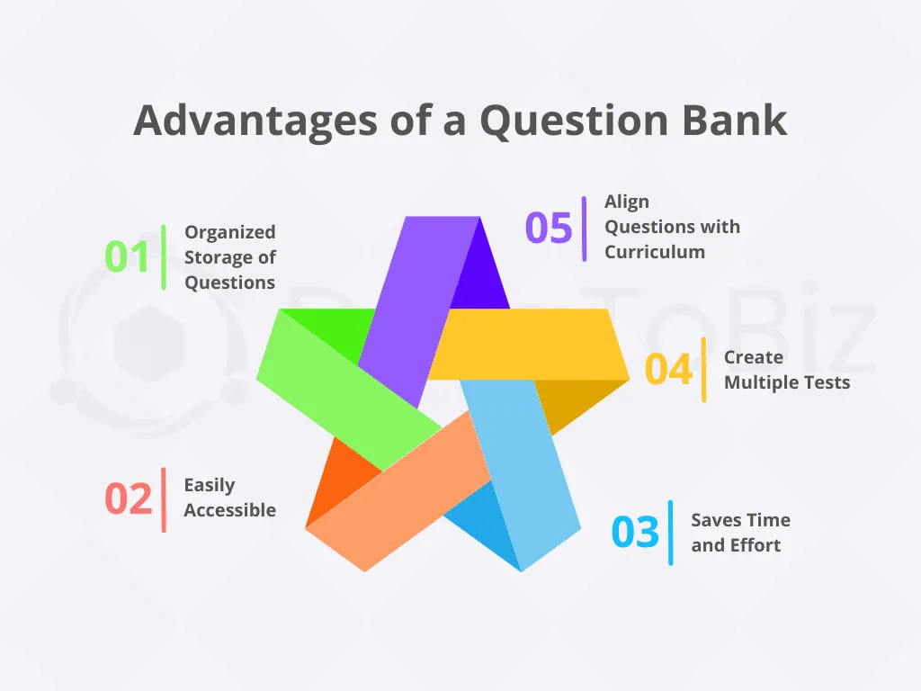
Question Bank
Prompt:
Generate a question bank for a college-level algorithms course covering parallel algorithms.
Create 100 questions total, distributed as follows:
- 20 basic recall questions (Bloom's level 1)
- 20 comprehension questions (Bloom's level 2)
- 20 application questions (Bloom's level 3)
- 20 analysis questions (Bloom's level 4)
- 20 synthesis/evaluation questions (Bloom's levels 5-6)
For each question:
1. Indicate the specific topic and learning objective
2. Note the difficulty level (1-5)
3. Provide the correct answer and explanation
4. For multiple choice questions, include 3-4 plausible distractors with explanations of why they're incorrect
Basic Question Bank Generation
Subject-Specific Adaptation
Customized Difficulty Distribution
Question Refinement
Learning Objective Alignment

Slide 76
Question Bank
Prompt:
I'm teaching Introduction to Biology at the college level. Based on the following key concepts from my lecture notes and syllabus, generate a balanced question bank:
Key Concepts:
Cell Theory and Cellular Organization - The understanding that all living organisms are composed of cells, cells are the basic unit of structure and function in living things, and all cells …
…
For each concept, create:
- 2 basic factual questions
- 3 application questions requiring students to apply the concept
- 1 complex scenario-based question requiring integration of multiple concepts
Format each question with:
- Question text
- Answer key with detailed explanation
- Estimated time to answer
- Difficulty rating (1-5)
Basic Question Bank Generation
Subject-Specific Adaptation
Customized Difficulty Distribution
Question Refinement
Learning Objective Alignment

Slide 77
Question Bank
Prompt:
Create an exam question bank for my business statistics class with this specific difficulty distribution:
- 20% Easy questions (students with basic understanding should answer correctly)
- 50% Medium questions (students with solid understanding should answer correctly)
- 20% Challenging questions (only students with thorough understanding will answer correctly)
- 10% Advanced questions (designed to differentiate top performers)
Include a mix of multiple choice, multiple answer, true/false, and matching question types. For each question, provide:
1. The question
2. Sample answer or solution
3. Grading rubric with point allocation
4. Common misconceptions or errors to watch for
Basic Question Bank Generation
Subject-Specific Adaptation
Customized Difficulty Distribution
Question Refinement
Learning Objective Alignment

Slide 78
Question Bank
Prompt:
Review and improve the following exam questions for my Introduction to Psychology course:
For each question:
1. Assess clarity and precision of language
2. Evaluate the difficulty level (1-5)
3. Suggest improvements to make the question more effective
4. Identify any potential issues (ambiguity, cultural bias, etc.)
5. Provide an improved version of the question
Basic Question Bank Generation
Subject-Specific Adaptation
Customized Difficulty Distribution
Question Refinement
Learning Objective Alignment

Slide 79
Prompt:
Question Bank
Based on these course learning objectives, generate appropriate assessment questions:
Learning Objectives:
Analyze Primary Sources: Students will be able to critically analyze primary historical documents from different time periods in American history, identifying the author's perspective, historical context, and significance to broader historical developments.
Explain Major Historical Shifts: Students will be able to explain the causes, key events, and consequences of major transformations in American history (such as the American Revolution, Civil War, Progressive Era, Great Depression, and Civil Rights Movement), demonstrating understanding of how these events connect to larger historical patterns.
Evaluate Historical Interpretations: Students will be able to compare and evaluate competing historical interpretations of significant events or periods in American history, recognizing how historiography evolves and how historical narratives are shaped by the time in which they are written.
For each learning objective, create:
- 3 questions that directly assess mastery of this objective
- Vary question types and difficulty levels
- Indicate how each question maps to the objective
- Provide grading criteria that aligns with the objective's importance
Basic Question Bank Generation
Subject-Specific Adaptation
Customized Difficulty Distribution
Question Refinement
Learning Objective Alignment

Slide 80
AI Productivity Toolkit
Rubric Creation with Style Integration

Slide 81
Create a detailed assessment rubric for a upper-level psychology research methods course.
Assignment Description:
Students will work in groups of 3-4 to design and present a proposed psychological experiment based on a research question of their choice. The presentation should be 15 minutes long with 5 minutes for questions and should include slides. Groups will present their research question, hypotheses, methodology, expected results, and potential implications.
Learning Objectives:
Develop a testable research question and hypotheses grounded in psychological theory
Design an appropriate experimental methodology with consideration of validity and ethical issues
Demonstrate understanding of appropriate statistical analyses for the proposed research design
Include 4-5 assessment dimensions with criteria for excellent, proficient, developing, and unsatisfactory performance.
Rubric Creation
Benefits of AI-Assisted Rubric Creation
Efficiency: Generates comprehensive first drafts of rubrics in minutes rather than hours
Consistency: Ensures alignment between learning objectives and assessment criteria
Comprehensiveness: Helps identify assessment dimensions that might be overlooked
Standardization: Maintains consistent language and structure across course rubrics
Adaptability: Easily customizes generic rubrics for specific assignments or disciplines
Notes:
SHOW FILE: GROUP RESEARCH PRESENTATION RUBRIC.PDF

Slide 82
Create a rubric for evaluating student projects in my Mechanical Engineering course that:
1. Incorporates discipline-specific expectations about
ABET criteria for engineering design
ASME/IEEE professional standards for technical documentation
…
2. Aligns with these program outcomes:
Apply engineering principles to identify, formulate, and solve complex engineering problems
…
3. Uses a [3/4/5]-level scoring system
4. Includes both quantitative scores and qualitative descriptors
5. Provides clear distinctions between performance levels
The rubric should be appropriate for undergraduate students and reflect current best practices in Mechanical Engineering education.
Rubric Creation
Benefits of AI-Assisted Rubric Creation
Efficiency: Generates comprehensive first drafts of rubrics in minutes rather than hours
Consistency: Ensures alignment between learning objectives and assessment criteria
Comprehensiveness: Helps identify assessment dimensions that might be overlooked
Standardization: Maintains consistent language and structure across course rubrics
Adaptability: Easily customizes generic rubrics for specific assignments or disciplines
Notes:
SHOW FILE: ENGINEERING DESIGN PROJECT EVALUATION RUBRIC.PDF

Slide 83
AI Productivity Toolkit
Communication Style, Tone, and Structure

Slide 84

Implementation Techniques
Communication Style, Tone, and Structure
Two-stage approach
Custom Instructions
Iterative Refinement
Template Creation Strategy
It is easy to get AI to match your communication style during the creation activities.

Slide 85
Create an email template for announcing our annual department review process to faculty.
Match my communication style with these characteristics:
I use a supportive but direct tone that acknowledges faculty workloads
I typically begin emails with context before introducing new requirements
I use bullet points for action items and deadlines
I avoid administrative jargon when possible
I include a personal note of encouragement in my conclusion
I typically sign off with "Collegially," rather than "Regards" or other closings
Here's an example of a previous email I sent to faculty:
[PASTE EXAMPLE EMAIL]
The email should include:
1. Reminder of the purpose of annual reviews
2. Key dates for submission of materials
3. Changes to the process from last year
4. Where to find resources and templates
5. Offer for one-on-one support
Communication Style, Tone, and Structure
It is easy to get AI to match your communication style during the creation activities.
Examples

Slide 86

Style Analysis
Prompt:
Analyze these sample emails I've sent to students: [examples]
Identify key elements of my communication style, tone, and structure
Email
Templates
In my writing style
AI can help generate various templates while preserving your unique communication style, tone, and organizational structure. These customized templates maintain your personal approach to communication throughout.
Notes:
SHOW FILES: 5 SAMPLE EMAIL TO STUDENTS.TXT

Slide 87
Style Analysis
Prompt:
Analyze these sample emails I've sent to students: [examples]
Identify key elements of my communication style, tone, and structure
Template Creation
Prompt:
Using my identified communication patterns and following institutional guidelines in custom instructions, create templates for:
- Late assignment responses
- Academic integrity concerns
- Progress updates
…
Email
Templates
In my writing style
AI can help generate various templates while preserving your unique communication style, tone, and organizational structure. These customized templates maintain your personal approach to communication throughout.
Notes:
SHOW FILE: STUDENT EMAIL ANLAYSIS RESULTS.TXT

Slide 88

Progressive Customization
Assignment Design
1. Initial Setup:
Custom Instructions include: institutional policies, grading scales, and preferred terminology
2. Style Integration:
Prompt:
“Review these three assignments I've created: [examples]
Analyze my assignment structure and language patterns”
3. Final Production:
Prompt:
“Create a new assignment that:
- Follows the structural patterns you identified
- Incorporates our institutional requirements from custom instructions
- Maintains my voice and presentation style”
In my writing style

Slide 89
AI Productivity Toolkit
Statements on AI in Your Syllabus

Slide 90
Artificial Intelligence Policy
Definitions and Scope
For the purposes of this course, "AI tools" refers to generative artificial intelligence technologies including but not limited to: ChatGPT, Claude, Gemini, DALL-E, Midjourney, and similar large language or image generation models.
Syllabus and AI
The rapid integration of artificial intelligence tools into the academic landscape necessitates clear policy guidelines in course syllabi.
Definitions and Scope
General Policy on AI Use
Prohibited Uses
Permitted Uses
Disclosure Requirements
Consequences of Policy Violation
Rationale
Questions About AI Use

Slide 91
Artificial Intelligence Policy
General Policy on AI Use
This course primarily restricts the use of AI tools in assignment completion. However, limited applications are permitted with proper disclosure, as detailed below.
Syllabus and AI
The rapid integration of artificial intelligence tools into the academic landscape necessitates clear policy guidelines in course syllabi.
Prohibited Uses
The following uses of AI are strictly prohibited in this course:
1. Assignment Completion: Using AI to generate essays, complete problem sets, write code, or produce any work that is submitted as your own original thinking.
2. Response Generation: Using AI to formulate responses to discussion questions without substantial editing and intellectual contribution.
3. Exam Assistance: Using AI during any quiz, test, or examination.
4. Undisclosed Use: Any use of AI tools that is not explicitly disclosed as outlined below.
Definitions and Scope
General Policy on AI Use
Prohibited Uses
Permitted Uses
Disclosure Requirements
Consequences of Policy Violation
Rationale
Questions About AI Use

Slide 92
Artificial Intelligence Policy
General Policy on AI Use
This course primarily restricts the use of AI tools in assignment completion. However, limited applications are permitted with proper disclosure, as detailed below.
Syllabus and AI
The rapid integration of artificial intelligence tools into the academic landscape necessitates clear policy guidelines in course syllabi.
Permitted Uses (With Required Disclosure)
AI tools may be used in limited ways with proper disclosure:
1. Brainstorming: You may use AI to generate initial ideas, provided that you substantially develop these ideas using your own critical thinking.
2. Editing Assistance: You may use AI for grammar checking, sentence structure refinement, or clarity improvement (similar to Grammarly).
3. Research Organization: You may use AI to help organize research notes or synthesize information from sources you have already read and understood.
Definitions and Scope
General Policy on AI Use
Prohibited Uses
Permitted Uses
Disclosure Requirements
Consequences of Policy Violation
Rationale
Questions About AI Use

Slide 93
Artificial Intelligence Policy
Disclosure Requirements
When AI tools are used in permitted ways, you must:
Syllabus and AI
The rapid integration of artificial intelligence tools into the academic landscape necessitates clear policy guidelines in course syllabi.
1. Include an "AI Disclosure Statement" at the end of your assignment that specifies:
- The specific AI tool used
- The exact portions of work where AI was utilized
- How you used the AI (e.g., "I used ChatGPT to help brainstorm initial topic ideas, then developed my own thesis")
- The exact prompts you used (copy and paste)
Definitions and Scope
General Policy on AI Use
Prohibited Uses
Permitted Uses
2. Submit both the AI-generated content and your final work to demonstrate your intellectual contribution.
Disclosure Requirements
Consequences of Policy Violation
Rationale
Questions About AI Use

Slide 94
Artificial Intelligence Policy
Consequences of Policy Violation
Undisclosed use of AI tools will be treated as academic dishonesty according to the university's academic integrity policy. Consequences may include:
- Receiving a zero on the assignment
- Failing the course
- Referral to the Office of Academic Integrity
Syllabus and AI
The rapid integration of artificial intelligence tools into the academic landscape necessitates clear policy guidelines in course syllabi.
Definitions and Scope
General Policy on AI Use
Prohibited Uses
Permitted Uses
Disclosure Requirements
Consequences of Policy Violation
Rationale
Questions About AI Use

Slide 95
Artificial Intelligence Policy
Rationale
This policy is designed to:
1. Maintain the integrity of your learning experience
2. Ensure fair assessment of your abilities and knowledge
3. Develop critical thinking skills that cannot be outsourced to AI
4. Prepare you for professional environments where understanding the appropriate use of AI tools is increasingly important
Syllabus and AI
The rapid integration of artificial intelligence tools into the academic landscape necessitates clear policy guidelines in course syllabi.
Definitions and Scope
General Policy on AI Use
Prohibited Uses
Permitted Uses
Disclosure Requirements
Consequences of Policy Violation
Rationale
Questions About AI Use

Slide 96
Artificial Intelligence Policy
Question About AI Use
If you are uncertain whether a specific use of AI is permitted, please ask me before proceeding.
Syllabus and AI
The rapid integration of artificial intelligence tools into the academic landscape necessitates clear policy guidelines in course syllabi.
Definitions and Scope
General Policy on AI Use
Prohibited Uses
Permitted Uses
Disclosure Requirements
Consequences of Policy Violation
Rationale
Questions About AI Use

Slide 97
# Artificial Intelligence Policy
## Definitions and Scope
For the purposes of this course, "AI tools" refers to generative artificial intelligence technologies including but not limited to: ChatGPT, Claude, Gemini, DALL-E, Midjourney, and similar large language or image generation models.
## General Policy on AI Use
This course primarily restricts the use of AI tools in assignment completion. However, limited applications are permitted with proper disclosure, as detailed below.
## Prohibited Uses
The following uses of AI are strictly prohibited in this course:
1. **Assignment Completion**: Using AI to generate essays, complete problem sets, write code, or produce any work that is submitted as your own original thinking.
2. **Response Generation**: Using AI to formulate responses to discussion questions without substantial editing and intellectual contribution.
3. **Exam Assistance**: Using AI during any quiz, test, or examination.
4. **Undisclosed Use**: Any use of AI tools that is not explicitly disclosed as outlined below.
## Permitted Uses (With Required Disclosure)
AI tools may be used in limited ways with proper disclosure:
1. **Brainstorming**: You may use AI to generate initial ideas, provided that you substantially develop these ideas using your own critical thinking.
2. **Editing Assistance**: You may use AI for grammar checking, sentence structure refinement, or clarity improvement (similar to Grammarly).
3. **Research Organization**: You may use AI to help organize research notes or synthesize information from sources you have already read and understood.
## Disclosure Requirements
When AI tools are used in permitted ways, you must:
1. Include an "AI Disclosure Statement" at the end of your assignment that specifies:
- The specific AI tool used
- The exact portions of work where AI was utilized
- How you used the AI (e.g., "I used ChatGPT to help brainstorm initial topic ideas, then developed my own thesis")
- The exact prompts you used (copy and paste)
2. Submit both the AI-generated content and your final work to demonstrate your intellectual contribution.
## Consequences of Policy Violation
Undisclosed use of AI tools will be treated as academic dishonesty according to the university's academic integrity policy. Consequences may include:
- Receiving a zero on the assignment
- Failing the course
- Referral to the Office of Academic Integrity
## Rationale
This policy is designed to:
1. Maintain the integrity of your learning experience
2. Ensure fair assessment of your abilities and knowledge
3. Develop critical thinking skills that cannot be outsourced to AI
4. Prepare you for professional environments where understanding the appropriate use of AI tools is increasingly important
## Questions About AI Use
If you are uncertain whether a specific use of AI is permitted, please ask me before proceeding.
## Modifications to This Policy
As AI technologies evolve rapidly, this policy may be updated during the semester with appropriate notice.
---
*By remaining enrolled in this course, you acknowledge that you have read, understand, and agree to abide by this AI use policy.*
jdeterra.com

Slide 98


